Slide 1

Monocular Depth Estimation using CARLA
Acey Dufresne
Advisor: Soomok Lee

Slide 2
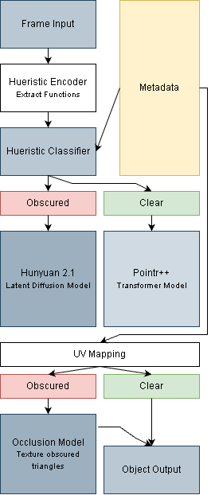
Overview:

Slide 3
Introductory Definitions:
Depth Estimation: How far an object is from the viewpoint camera, a deformation of the input.
-Two-dimensional array of depths
Three Dimensional Generation/Reconstruction: Taking a two-dimensional input and constructs a three-dimensional representation, including hidden geometry.
  -Three-dimensional object output

Slide 4
Introductory Definitions:
Latent Diffusion Architecture: Multiple passes through one transformer, that uses the same denoising patterns to pass the output of the previous ‘sweep’ as inference to the current iteration.
Traditional Transformer Architecture: One forward pass through one transformer.

Slide 5
What is CARLA:
CARLA, Compositing and Relighting algorithm is a method of converting two-dimensional input into three-dimensional output.

Slide 6
What does CARLA do?
There are three primary goals for the algorithm:
Can image contours provide enough information to reconstruct 3D shape?
(Geometry based features)
Can the model complete regions hidden in the input image?
Can selective completion reduce computation at matched accuracy?
  (Can we keep the performance of deep learning models with heuristic computational levels)

Slide 7
How do we accomplish this?
A custom heuristic geometry-based encoder
A custom un-supervised heuristic classifier
Dual model architecture to reduce computational workloads

Slide 8
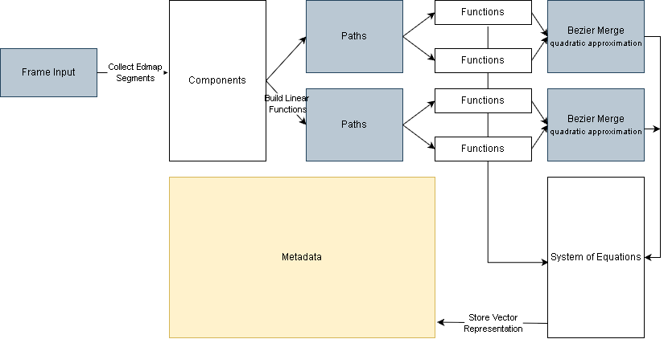
Implementing the Encoder:

Slide 9

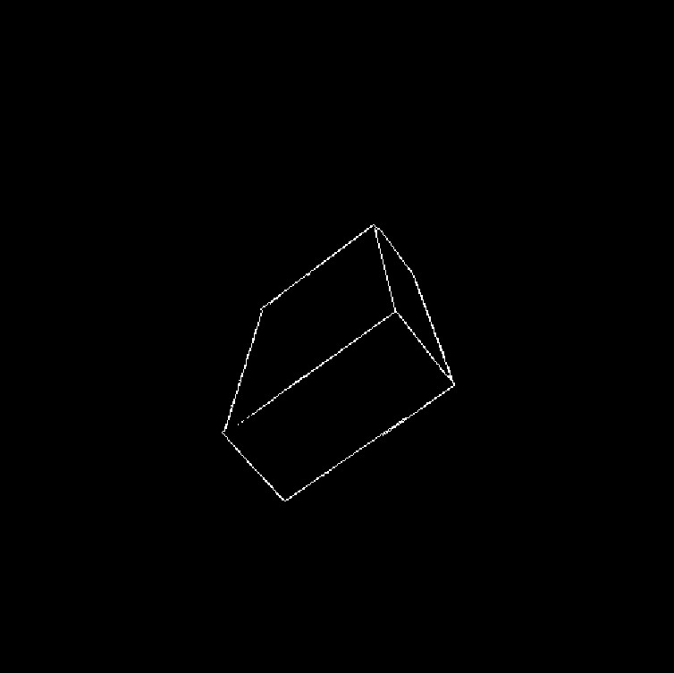
Implementing the Encoder:
The model is passed some two-dimensional input:
The algorithm runs a Sobel Edge Detector of the input:
-We run a skeletolize operator as well;

Slide 10
Implementing the Encoder:
Use some concepts from graph theory to break edge map into components, all connected pixels together→
By definition, if a component has an endpoint, it can be a directed graph(linked list in computer science), set the head node as the first encountered endpoint, first neighboring pixel becomes the sliding tail→

Slide 11
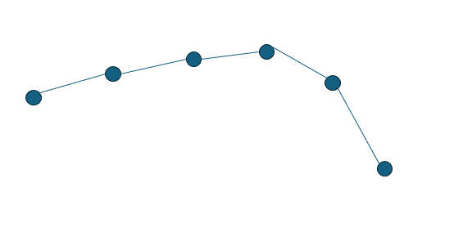
Implementing the Encoder:
Move tail node to the next neighbor, calculate slope:
We use a distance and angle threshold to ensure we only record linear functions.
How do we use the formula: ‘y=mx+b’ (standard slope formula) to represent vertical assymtopes?
Instead we use the General Linear Equation: ‘Ax + Bx + C = 0.’

Slide 12
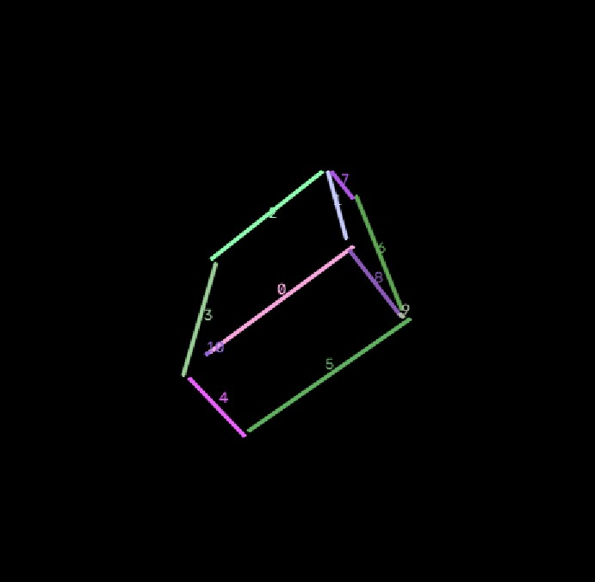
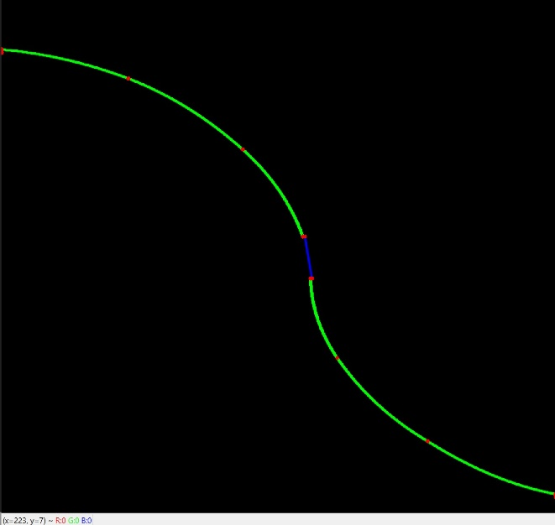
Implementing the Encoder:
Using this method we can rebuild all linear functions:
How do we deal with quadratic equations?
We use a Bezier curve, which utilizes weights to influence a linear function. We can now represent all functions in an image.

Slide 13
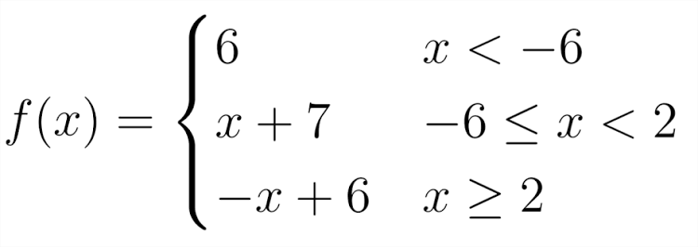
Implementing the Encoder:
Once we have all functions of a component, we can borrow some ideas from Calculus and combine them
into a piecewise equation:
And we combine all components into a system of equations:
(It is important to note, we are plotting all functions in the 1st quadrant)
{ }
f(x)
g(x)
h(x)

Slide 14
Implementing the Tokenizer:
The image has now been vectorized and been converted into an SVG, we need to convert this vectors into a language a transformer can understand.
We use sqLite to create a database which houses every function encountered in the dataset:
Integer A
Integer B
Integer C
-[A,B] bounds
Function ID
Integer A
Integer B
Integer C
-[A,B] bounds
Function ID
Neighbor Reference

Slide 15
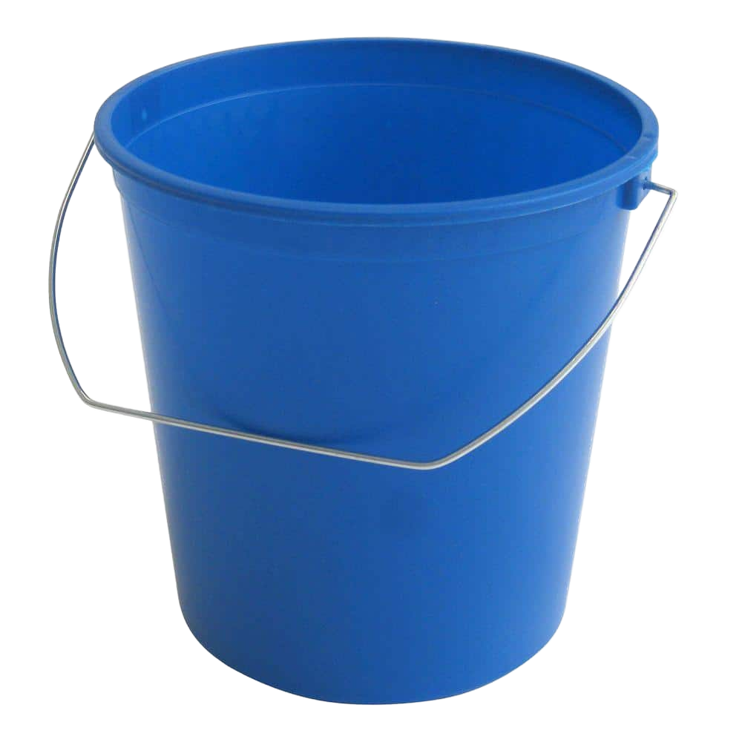
Encoder/Tokenizer Transition:
We use a hash bucket system, in addition to a KNN to store the functions. We’re using the distance and angle thresholds from the encoder to determine which functions are grouped together, this is to increase lookup efficiency later.
Input function
Linear Functions
Quadratic Functions
< Ax + Bx + C
< 2Ax + 2Bx + 2C

Slide 16
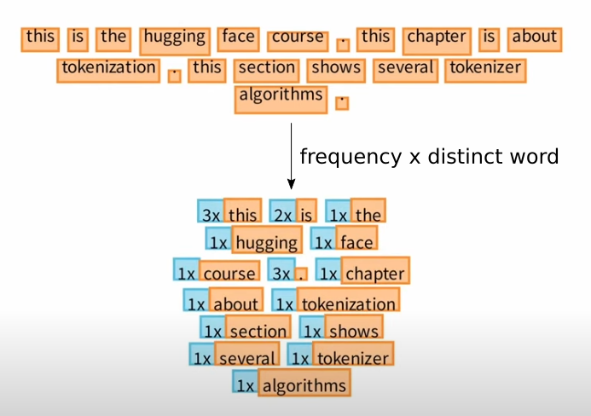
Implementing the Tokenizer:
We create a token for each independent function, ie: ‘A,’ ‘B.’ We then convert an NLP BPE merge(Byte Pair Encoding) algorithm to create a greater context, ie: ‘AB.’
This allows us to rebuild images with tokens only(It is important to note tokens are kept bounded).

Slide 17
Implementing the Tokenizer:
Once we have all the tokens, composite and standard, we go to the reference json data set and rebuild the virtual blender environment for each mesh, and create a ray from each node in the edgemap’s function to it’s intersecting global coordinate on the mesh, giving us an absolute depth.
edgemap
raycast
Rendered mesh

Slide 18
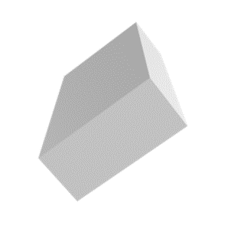
Implementing the Classifier:
We now have a translation from input→encoder→classifier.

Slide 19
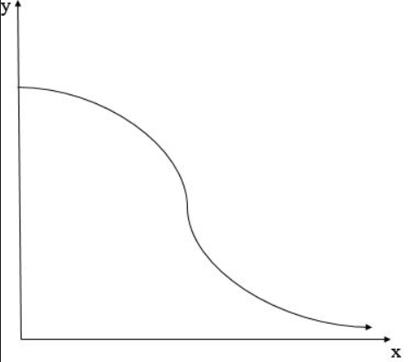
Implementing the Classifier:
When we take input, we use three levels of abstraction to find the most similar reference matches:
Top level of abstraction: exact matches, input token ‘x == A’
==

Slide 20
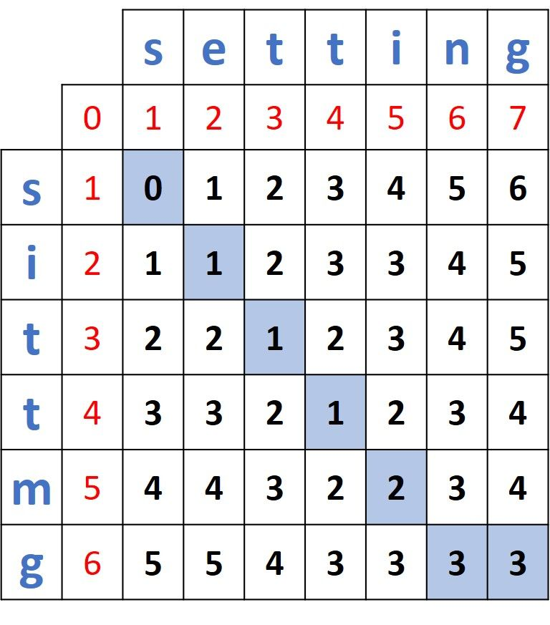
Implementing the Classifier:
If we cannot find exact matches, we borrow a method from NLP again and use Levenshtein Distance:

Slide 21
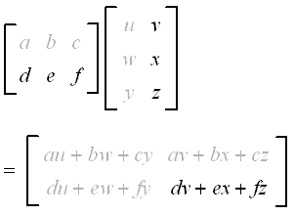
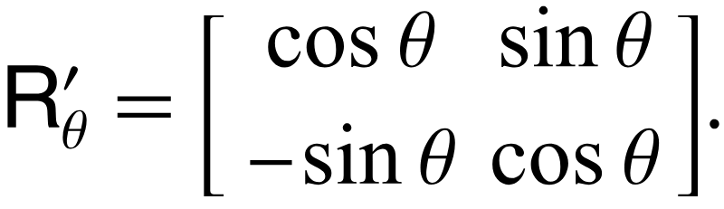
Implementing the Classifier:
Lowest level of abstraction: We use the hash bucket, and use scalar operations on individual functions:
3Ax + 2Bx + C[2a,2b] == A x+ Bx + C [a, b]
*three scalar operations
-function substitution
-double scaling of endpoints

Slide 22
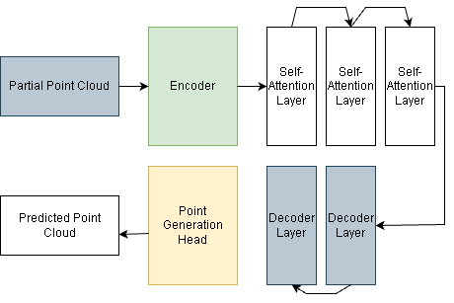
Model Architecture:
Pointr++, simple transformer model, trained on 240 meshes, and 2880 images

Slide 23
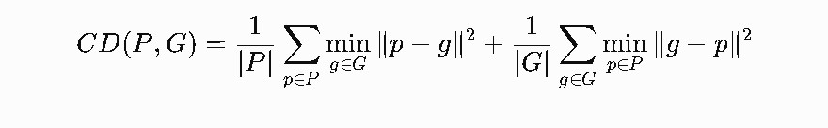
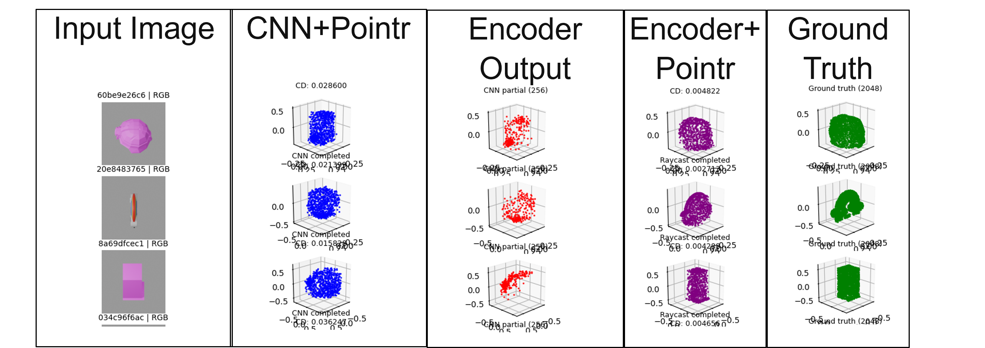
Current Results:
Measured using Chamfer distance:
Best results:
MobileNet Encoder: .01743656
CARLA Encoder: .00366064

Slide 24
Current Results:
Ablation Test: For this test, we want to see how well the model would do without the proposed heuristic encoder. To do this we used the same transformer model: Pointr++ architecture, gave it a set output of output Point cloud vectors, and required each encoder to predict partial pointclouds consisting of 256 vectors each.

Slide 25
Current Results:
Ablation Test: Both MobileNetV3 small and CARLA were given 240 meshes, paired with 2,880 images, for MobileNet to train on, and for CARLA to use as reference. MobileNet was given 100 epochs to train, with a batch size of 4. CARLA was supposed to only have the initial reference set.

Slide 26
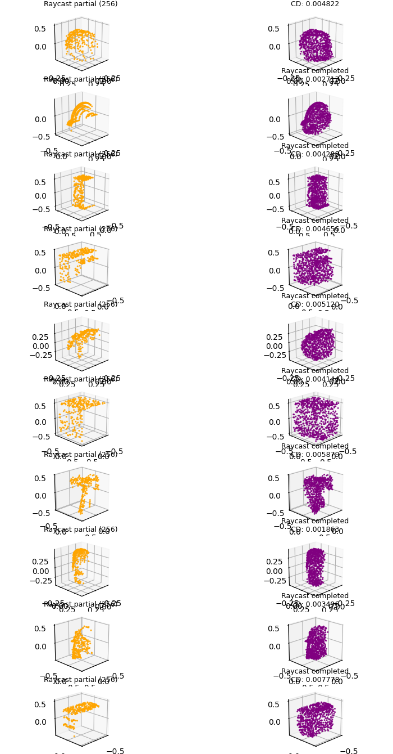
Current Results:
Partial Data Viewed: Final Output:
How is CARLA predicting five times more accurate point clouds than the MobileNetV3 encoder?
This was the most recent testing done for C-Day preperation, and several mistakes were made during the training phase. Most importantly, the heuristic edge encoder uses reference rather than learning any patterns, when I ran the test, I accidentally was allowing the CARLA encoder to reference the entire dataset, including the test set. Essentially it was able to see this information:

Slide 27
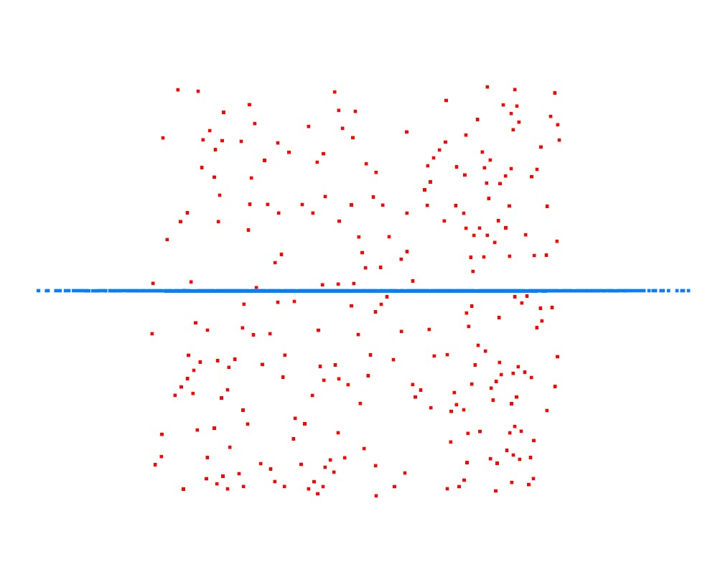
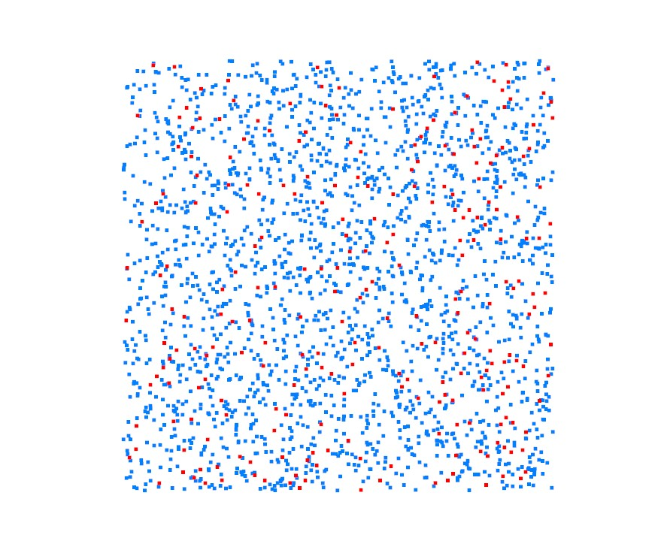
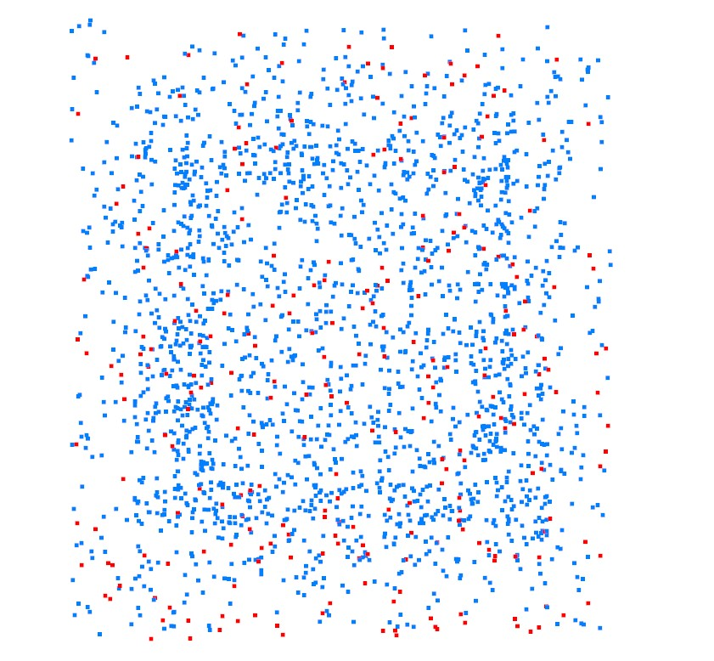
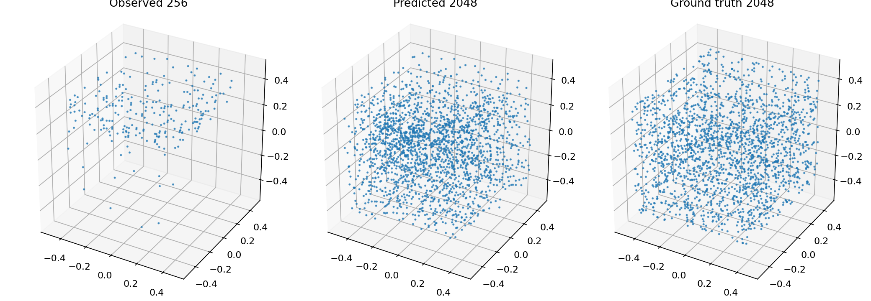
Current Results:
Why did MobileNet struggle so much?
Not enough data to extract features, compared to CARLA only needing enough to generate 256 partial vectors.
Epoch 10
Epoch 30
Epoch 100

Slide 28
Current Results:
Interestingly after removing the test set from CARLA’s reference parameters, it was still producing results at an average Chamfer distance of .01946. This is well beyond what was expected, and the only explanation is that inside of the sqLite tables some of the test set is still initialized:

Slide 29
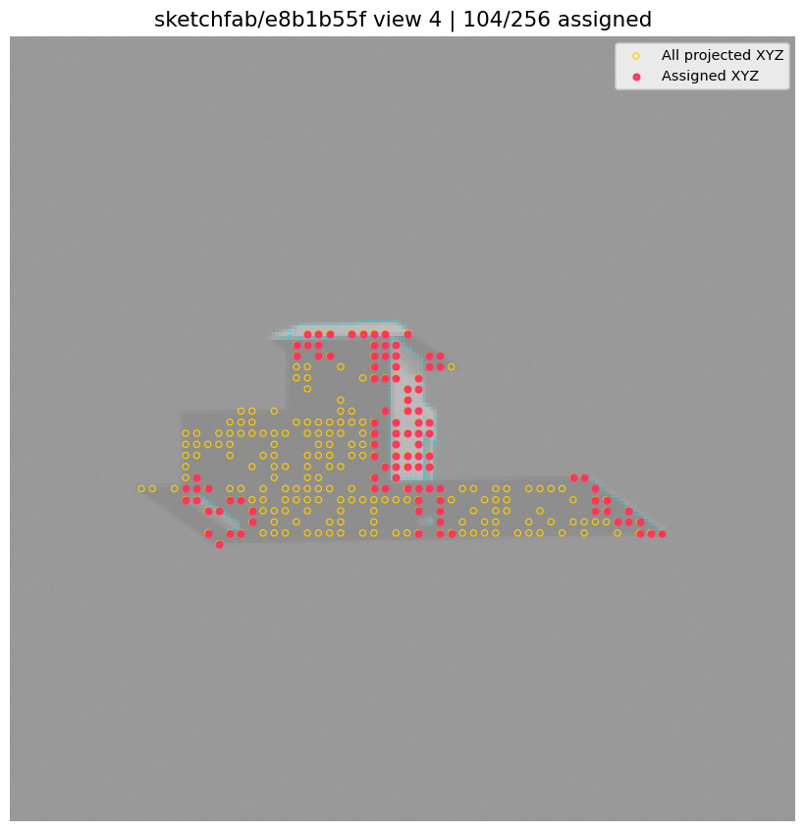
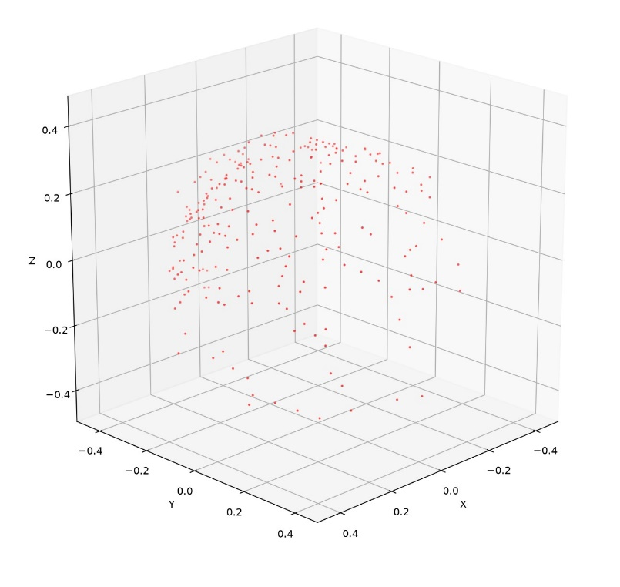

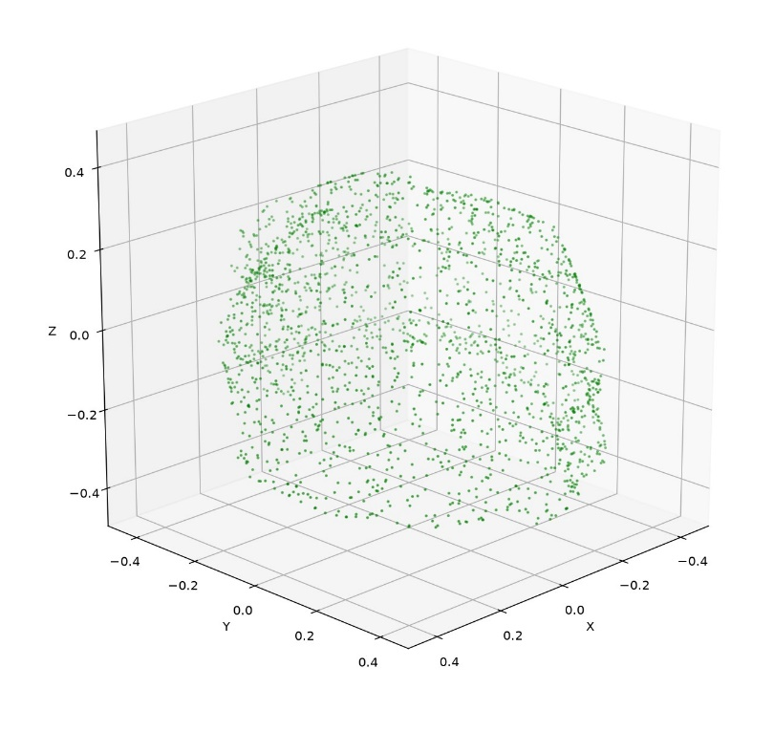
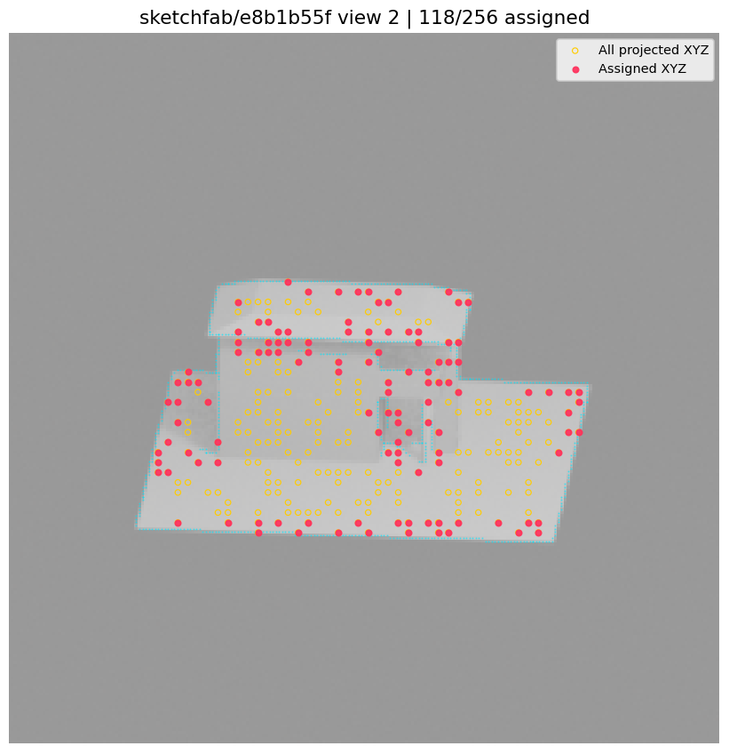
Current Results:
Ground Truth/
Correct Answers
Encoder Partial Output:
Model Final Prediction:

Slide 30
Future Goals
Complete computational comparison tests between MobileNet and CARLA
Finish and Implement Decoder
(Potential) Implement and build Occlusion Topology/texture generator for Decoder
(Potential) Implement Latent Diffusion Model

